Slide 1
ASSIGNMENT Name: …………Sheya Dey………………..
Problem Statement
Bank of Corporate conducted a telemarketing campaign for one of its financial products, ‘Term deposits’, to build a long-term relationship with the existing customers. Your goal is to identify the target customers for the term deposits from the pool of the bank’s existing customers. You should also capture the key driving factors (or driver variables) behind the successful conversion of a customer, i.e., the customer opening a term deposit account with the bank.
Assignment Objective
To identify the target customers and the driving factors behind a successful customer conversion for future marketing campaigns.
Notes:
Problem Statement

Slide 2
INDEX
CONTENTS
PAGE NO.
DATA CLEANING STEPS
UNIVARIATE ANALYSIS- AGE
UNIVARIATE ANALYSIS- JOB DISTRIBUTION
UNIVARIATE ANALYSIS- CASH BALANCE
UNIVARIATE ANALYSIS- IQR ANALYSIS & OUTLIERS OF CASH BALANCE
SEGMENTED UNIVARITE ANALYSIS- AGE Vs. Loan Default
SEGMENTED UNIVARITE ANALYSIS- Marital Status Vs. Housing Loan
SEGMENTED UNIVARITE ANALYSIS- Marital Status Vs. Personal Loan
BIVARIATE ANALYSIS- Age Group Vs. Median of Cash Balance
BIVARIATE ANALYSIS- Age Group Vs. Subscription Rate
BIVARIATE ANALYSIS- Education Vs. Marital status Vs. Subscription Rate
BIVARIATE ANALYSIS- Poutcome Vs. Subscription
BIVARIATE ANALYSIS- Job Vs. Median of Cash Balance Vs. Subscription
MAJOR INSIGHTS
1-2
3
4
5
6
7
8
9
10
11
12
13
14
15

Slide 3
Data Cleaning Steps
1
Duplicate Removal- The first step is to remove the duplicates from the Dataset and 416 duplicate rows were
removed. The method is mentioned below.
Changing Column Type- Changed column type of two columns, “Account No” to “String” &
“Cash Balance” to “Number”.
Replacing Invalid Values – 1.Age column had values containing “-” in front of the numbers which is
invalid . I replaced the “-” values with blank and around 15026 invalid values were replaced with valid ones. The steps are mentioned below using diagram.
2. Job column also had admin. & admin which means the same. I replaced “.” of “admin.” with “ “ following the same steps.
Step 1
Ctrl+A
Data Tab
Data Tools
Remove Duplicates
Select All Columns
Ok
Step 2
Step 3
Selected age column
Editing Group
Find & Replace
Find “-” Replace” “
Ok

Slide 4
Data Cleaning Steps
2
Date Column- Date column’’s data type couldn’t be identified by Excel. Changed the data type using the following.
method. At first , selected the whole date column without the column name> Data tab > Data Tools> Text to Columns> Delimited> Deselected all the options> Ok
Call duration column - Call Duration column’’s data type couldn’t be identified by Excel. Changed the data type
using the following method. Inserted two columns, Selected the whole column without the column name> data Tab> data tools> Text to Columns> Fixed Columns> Separated hour , mins & secs> In a different column used the formula “=Text(time( column containing hour, column containing min, column containing second ), “hh:mm:ss”)> Enter
Step 4
Step 5

Slide 5
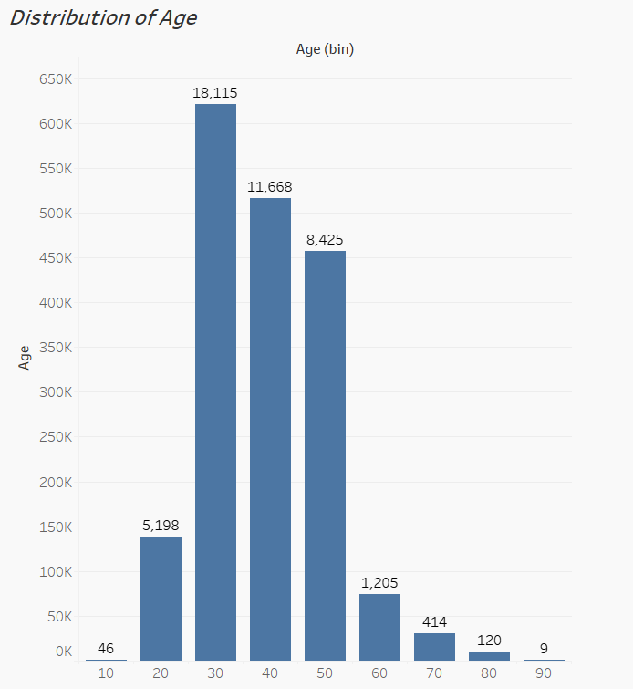
PART I : Univariate Analysis
3
As the first step, we’ll analyze the distribution of different variables.
Variable under consideration:
1. AGE: When we try to analyse the distribution of age, we see that most of the customers falls under the age range of “30-40”. The second highest age range falls under “40-50”.

Slide 6
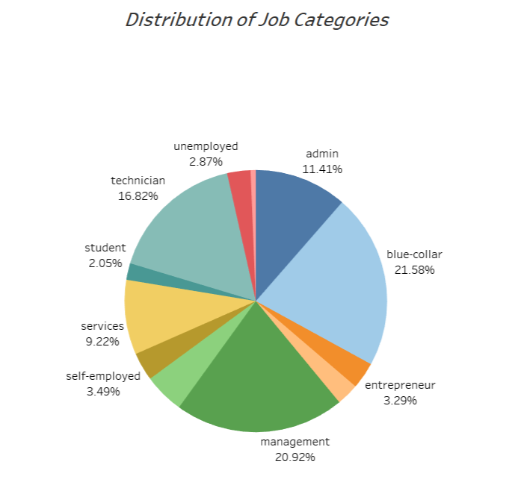
PART I : Univariate Analysis
4
Variable under consideration:
2. Job Distribution:- Here, We’re trying to analyse the distribution of job categories between our customers. As the picture below shows, we’ve Blue-Collar employees and Management employees as the top two job categories holding 21.58% & 20.92% of total customers.
Distribution of Job Categories

Slide 7
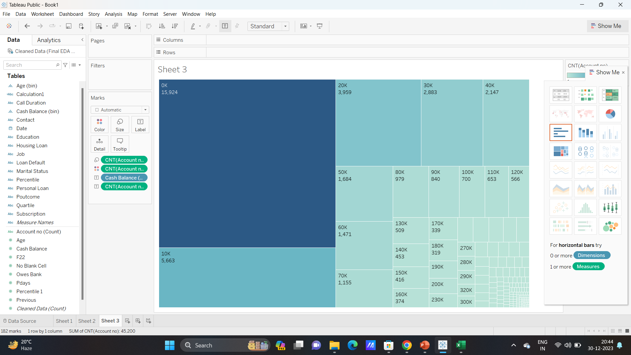
PART I : Univariate Analysis
5
Variable under consideration:
Cash Balance: To understand the distribution of cash balance I created different bins of 10000 rupees each, starting from 0. To visualise I created a tree map and it shows the most of the customers, numbering 15924 has a bank balance of “0-10000”. The second highest number of customers( almost 5633) has bank balance between 10000-20000.
Distribution of Cash Balance Among Customers

Slide 8
PART I : Univariate Analysis
6
Interquartile Difference & Outliers Of Cash Balance:
When we run a interquartile analysis of cash balance between the customers, we observe that the 25th Percentile or 1st Quartile of the Cash Balance is 3,550 and the 75th Percentile or 3rd Quartile is 71,163. Accordingly the IQR stands at 67,613.
On this basis if we create Lower Bound using the formula “=1st Quartile – 1.5 * IQR” it comes to “ -97,868.75”
& the Upper Bound using the formula “=3rd Quartile-1.5* IQR” it stands at “1,72,581.25”.
The data set contains 0 values lower than the Lower Bound but values higher than Upper Value counts 4727, which should not be removed.
We also can see that the 95th Percentile of customer balance stands at 2,88,705 which a 2,17,543 jump from the 75th Percentile.
Because we have outliers in our dataset, we’ll consider Median Value of Cash Balance rather than Mean Value. The Presence of outliers has increased the Mean or Average of Cash Balance, whereas the Median Value will not consider lowest values like “0” or the highest values.
Formula of Median Value “ =Median( Array of Cash Balance) > Enter”

Slide 9
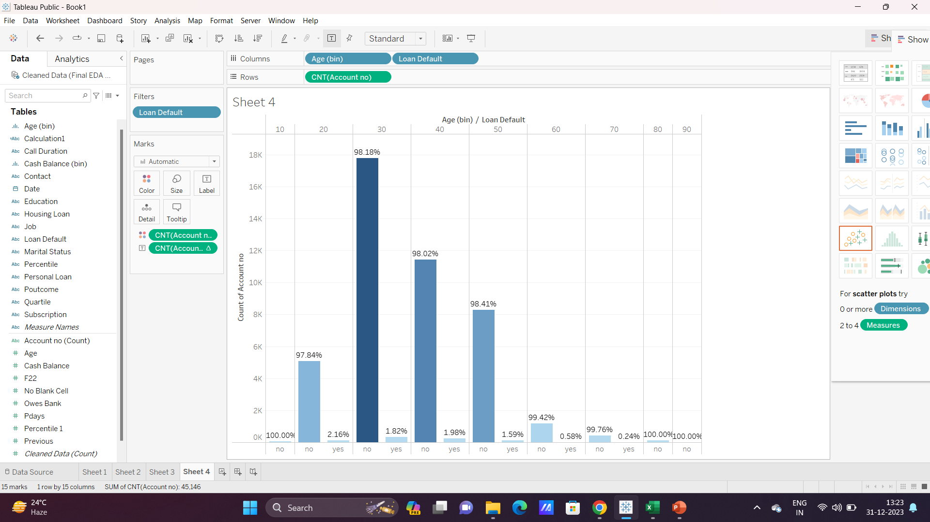
PART II : Segmented Univariate Analysis
7
Variables under consideration: AGE Vs. Loan Default
In this Step, we’ll analyze at which stage of age the customers are more likely to take loans and at which stage they are less likely. Customers are less likely to take loans might mean they have enough money to go on with their life. They can also have extra money to opt for a term deposit.
Age Group Vs. Percentage of customers having loan
Here, Age group of 10 was created for all the customers, where the first age group starts from 0-10 years of age and the last age group is of 90-100 years of age. As visible from the bar chart, the highest percentage of people having loan is from 20-30 years of age. After that age group of 40-50 has a good amount of percentage of people having loan. From age group 50-60 the percentage of loan borrowers has gradually decreased. But the number of account holders is also gradually decreasing from that age group. But the interesting point is, we do have the highest number of account holders from the age group of 30-40 & also the percentage of loan borrowers is quite less there standing only 1.82%.

Slide 10
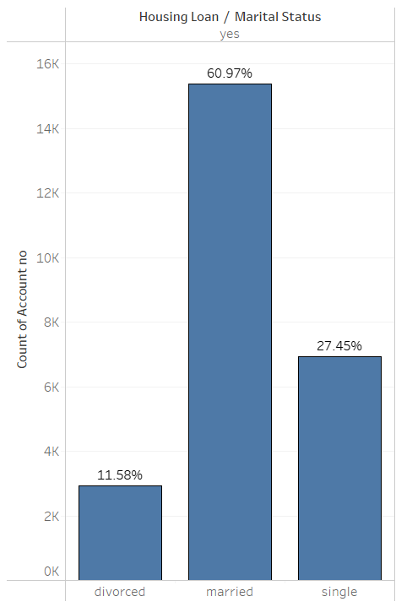
PART II : Segmented Univariate Analysis
8
Variables under consideration: Marital Status Vs. Housing Loan
In this part of analysis, we’ll try to observe the percentage of people having housing loan the most. I’ve plotted a bar chart in tableau by using Marital Status & Housing Loan as dimension & Count of Account Numbers as measure. Also have added Hosing Loan in the filter and filtered “Yes” meaning have considered only those having House Loan.
Marital Status Vs. Housing Loan
From the chart we can understand that married people are more likely to take House Loan than single or divorced people. Over 60% of the people having housing loans are Married, followed by Single category (27.45%) & Divorced category (11.45%) respectively.

Slide 11
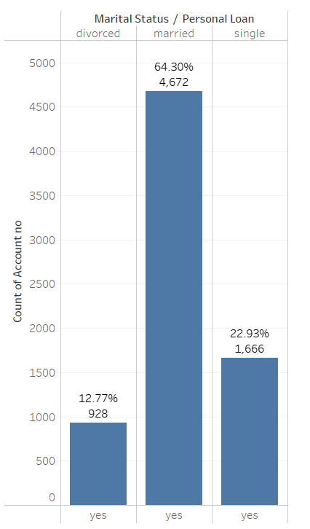
PART II : Segmented Univariate Analysis
9
Variables under consideration: Marital Status Vs. Personal Loan
In this part of analysis, we’ll try to observe the percentage of people having housing loan the most. I’ve plotted a bar chart in tableau by using Marital Status & Personal Loan as dimension & Count of Account Numbers as measure. Also have added Personal Loan in the filter and filtered “Yes” meaning have considered only those having Personal Loan.
Marital status Vs. Personal Loan
The Scenario is almost same for this section like the House Loan cases. Married people are most likely to take personal loans as well. Among the account holders who took personal loans, around 4672 people which is 64.30% of total are married , followed by Single category (only 22.93%) & Divorced category ( only 12.77%) respectively.

Slide 12
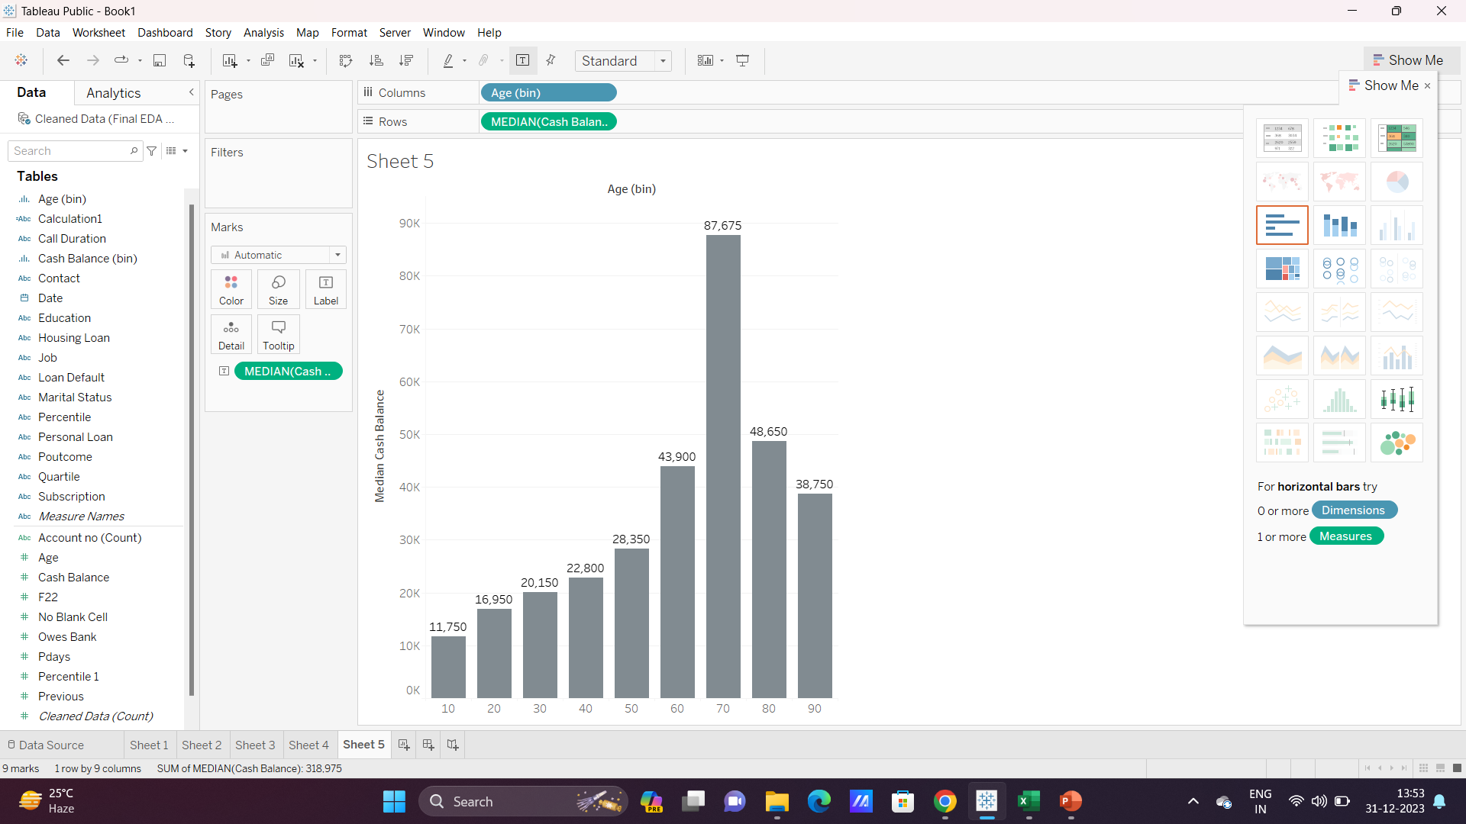
PART III : Bivariate Analysis
10
Variables under consideration: Age Group Vs. Median of Cash Balance
Here, we’ll analyse the Median of Cash Balance in respect with the Age Group. The reason behind considering the median value rather than the average/mean value is the presence of huge number of outliers which we analysed in the Univariate Analysis part. I have created bin of 10 each for the age group and created bar chart in respect with the median of cash balance in Tableau.
Age group Vs. Median of Cash Balance
As visible from the bar chart, though, we have the highest number of account holders from the age group of 30-40 years, their cash balance in account is very low, they are less likely to opt for term deposits. We’ve the highest median cash balance from the age group of 70-80 & also from the previous analysis we know that only 0.24% of people aging between 70-80 years has some kind of loan. We can start thinking from this prospective.

Slide 13
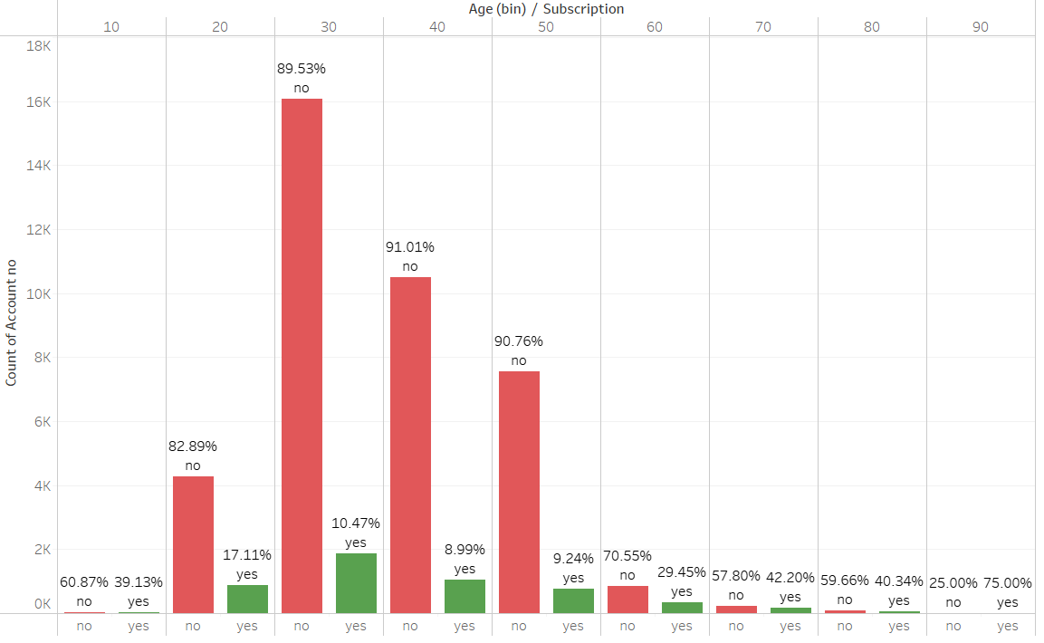
PART III : Bivariate Analysis
11
Variables under consideration: Age Group Vs. Subscription Rate
in this Part, we’ll analyse age group wise subscription rate. For this purpose I’ve created bin of age variable of 10 each starting from 0, i.e the first bin will be 0-10 years, the second will be 10-20 years and so on and analysed that will percentage of subscription. Let’s see how the graph shows.
Age Group Vs. Subscription Rate
As the chart shows, we can clearly see as the age group proceeds from 60-70 towards 90-100, though the number of account holders is getting lower, the chances of account holders to actually opt for the Term Deposit is actually increasing. For people ageing between 90-100 the chances of saying Yes is around 75% . So, people who are nearing retirement or already retired should be an area of priority we can understand. On the other hand, though the number of account holders aging between 20-50 years is way higher, the chances that they’ll be saying yes is pretty low, less than 20%.

Slide 14
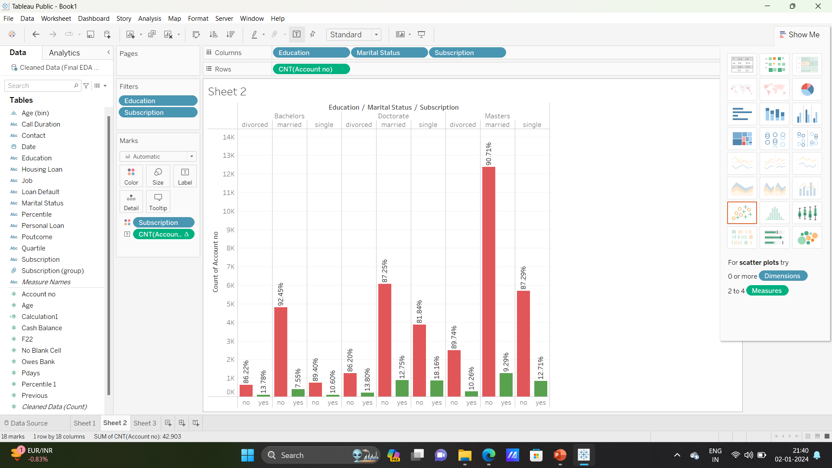
PART III : Bivariate Analysis
12
Variables under consideration: Education Vs. Marital Status Vs. Subscription Rate
The bar graph of Education & Marital Status wise Subscription Rate shows like this,
Education Vs. Marital Status Vs. Subscription Rate
As we've seen previously as well, married people are of the highest percentage of account holders having either housing loan or home loan. Here we can see that regardless of their education qualification they are always less likely to opt for the Term Deposit . For the other two categories i.e. divorced and single, the scenario is like the following-
Bachelor’s – Divorced>Single> Married
Master’s - Single>Divorced>Married
Doctorate - Single>Divorced>Married

Slide 15
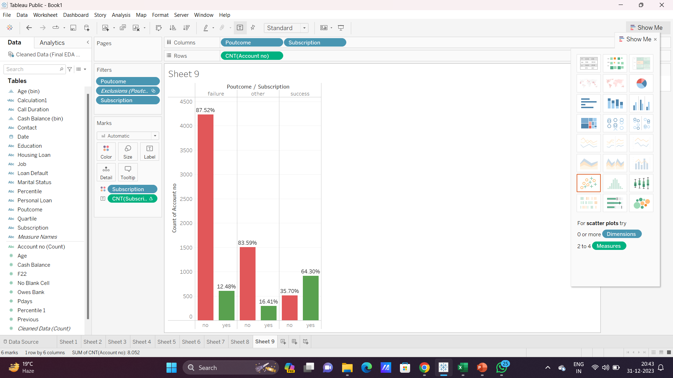
PART III : Bivariate Analysis
13
Variables under consideration: Poutcome Vs. Subscription
In this part of analysis, we’re going to observe what percentage of account holders who have been reached before with either Term Deposit offer or any other such kind of offers have opt for subscription this time. Here, Success means those account holders were previously reached out with other offers and there was a successful conversion. Failure means those account holders were previously reached out with other offers but they didn’t opt for the conversion and Other category includes those customers who didn’t give any definite answers when they were reached previously,( we can count those as failure because if there were a successful conversion, they’d be under Success category. Also yes means they have successfully opt for the Term Deposit offer this time, and No means there were negative pipeline conversion.
Poutcome Vs. Subscription
As the chart shows here, we can clearly understand that 64.30% of the people who previously successfully converted from prospective customers to customers have said “Yes” this time as well. So account holders who previously availed any service is more likely to avail this time as well. Marketing team should target this account holders first. Next, only 16.41% of account holders who didn’t gave any definite answers when reached earlier has successfully subscribed this time. And lastly those who didn’t opt for any plans previously, only 12.48% of them have successfully opt for the Term Deposit Plan this time. So our target should be
Account Holders with Successful Conversion earlier
Account Holders who gave indefinite answers earlier
Account Holders who said No earlier

Slide 16
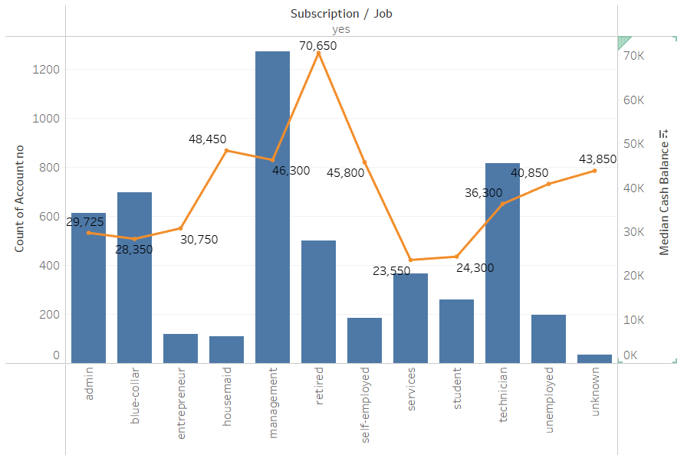
PART III : Bivariate Analysis
14
Variables under consideration : Job Vs. Median of Cash Balance Vs. Subscription
Here, I have taken four variables to understand the Job Vs Cash Balance Vs Subscription scenario i.e. Job, Subscription, Cash Balance, Count of Account Number. I have created a Dual Axis chart and also added subscription to the filter and only filtered customers who have responded yes, meaning opted for term insurance deposit.
Here, the Bar Chart shows the count of account numbers and the
Line Chart shows the median amount of cash balance. We can get
that the highest median amount of cash balance lies with the Retired
category, but the number of account holders are quite less from this
section. Same is applicable for the Housemaid, Self employed &
Unemployed category.
If we want to satisfy both the categories ( i.e. Number of Account
Holders & Higher Cash Balance), it’d definitely be Management
(more than 1200 account & 46,300 med.cash balance) & Technician
(more than 800 accounts & 36,300 med.cash balance) category,
followed by Admin & Blue Collar. Job Vs. Median of Cash Balance Vs. Subscription

Slide 17
PART IV: Major insights
15
Major chunk of people has cash balance equal or under 10,000. People having the major chunk of cash balance fall in the age group of 70-80 years of median cash balance of around 87000. Obviously people having more cash balance are more likely to opt for term deposit.
Married people has the highest percentage of loan borrowers both House Loan & Personal Loan. Also people between 20-30 years of age has the highest percentage of loan borrowers . It’s less likely that they will opt for Term deposits. Married people & people under 30 years of age should be the last to target.
Account Holders who have taken any kind of services are more likely to take Term Deposit offer. Around 64% of them has subscribed for Term deposits. They should be major area of targeting.
Job role wise the Retired employees have the highest median cash balance and around 1200 of them have also subscribed for term deposit. They should be the first to target followed by management, technician & admin employees because these categories have a large number of account holders opting for the Term Deposit & also they do have moderate cash balance in their account.
People aging more than 50 years are always more likely to get the subscription of the term deposit. For people aging 60+ years it’s around 30%, for 70+ it’s 42%, For 80+ it’s around 40 & for 90+ there’s a 75% chance. We definitiy should put more efforts after them.
Again, regardless of their education level, married people are always less likely to opt for Term Deposits. For the other two categories i.e. divorced and single, the scenario is like the following-
Bachelor’s – Divorced>Single> Married
Master’s - Single>Divorced>Married
Doctorate - Single>Divorced>Married
The difference between rate of subscription percentage between single & divorced people are not much, but we should put married people the last in the priority list on an average regardless of their age group.

